Slide 1




Pollutants R U.S.
Discovering Ozone,
Sulfur Dioxide,
Nitrogen Dioxide,
Carbon Monoxide,
and their impact on the Air Quality Index
by
Areeb Abubaker
Jordan Bickelhaupt
Sasha Rukhina
Julio Delgado
Jaime Moscoso

Slide 2
Introduction - Julio Delgado 1
In our data analysis we examined the different types of gases and pollutants that exist in the atmosphere of the United States. The data set has accumulated 16 years of data from 2000 to 2016. Our plan was to analyze the data and create a model that can predict the missing values of the pollutants,as well as creating a model for the air quality index.

Slide 3
Methodology - Jaime Moscoso
The data set that we are using is called “US Pollution Data” and we obtained the data set from Kaggle.com. Our plan is to analyze the various levels of pollutants to create a model that may predict the missing values of each AQI (NO2, O3, SO2, CO) and create and overall AQI We began exploring data by calculating the correlation for Mean and Max_Val for each pollutant and excluding the variables with low correlation. Excluding the variables one at a time will increase the adjusted R-squared value which would develop an accurate model to predict AQI.

Slide 4
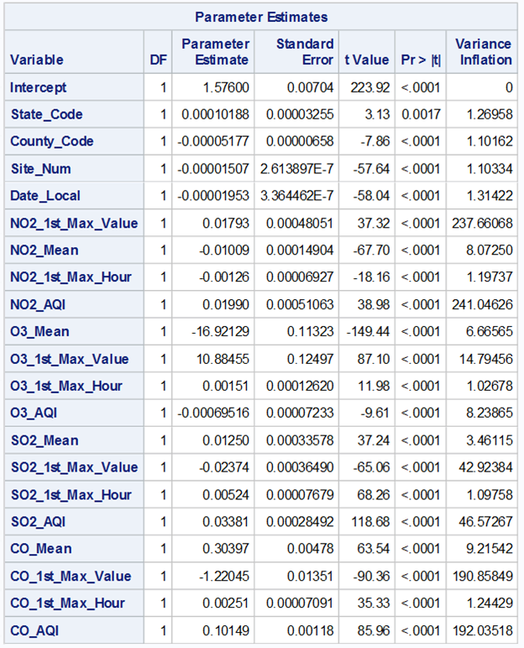
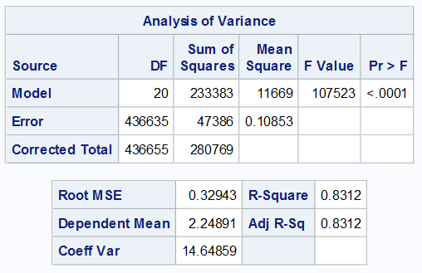
Jordan Bickelhaupt
Data Prep:
Investigating Collinearity

Slide 5
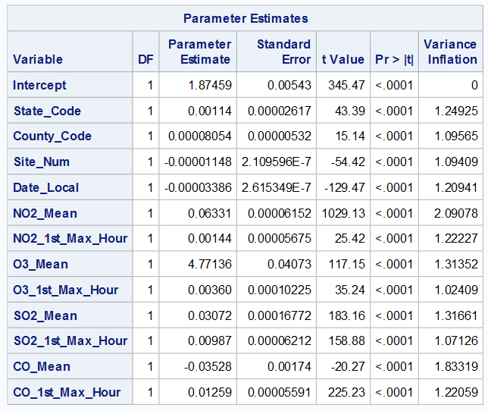
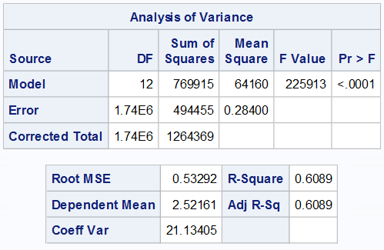
Verify collinearity is resolved

Slide 6
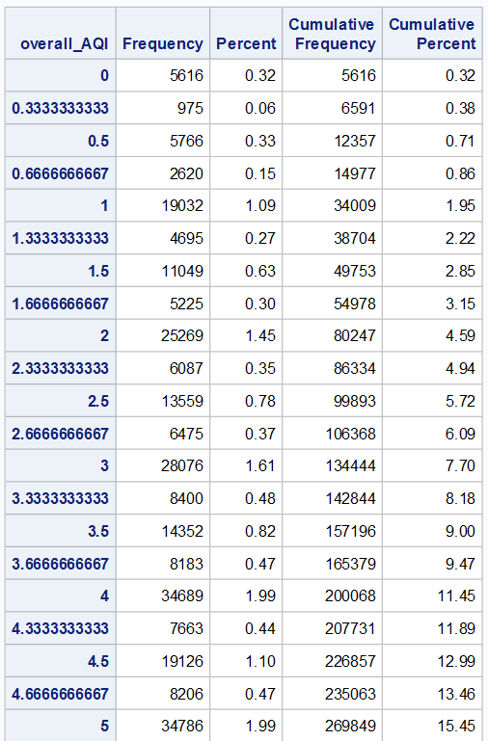
Freq procedure to analyze distribution

Slide 7
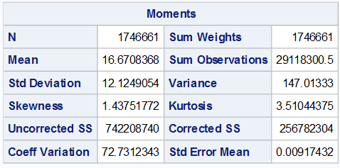
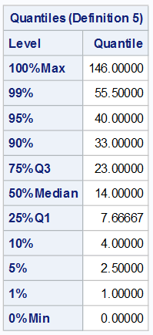
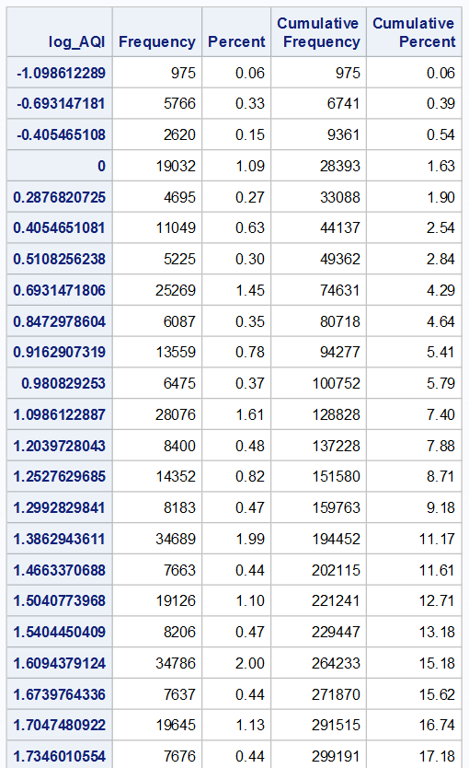
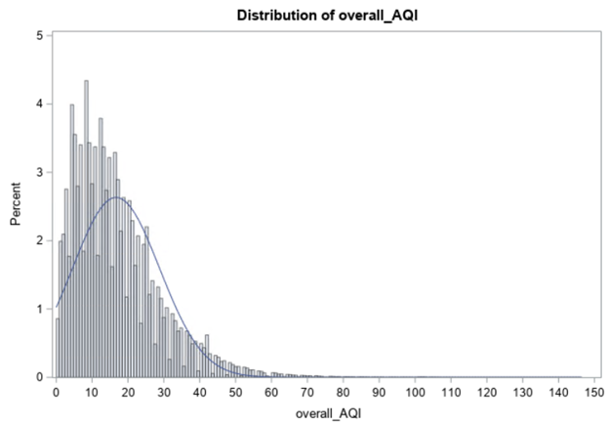
Exploring the newly created predictor value
overall_AQI = Mean(NO2_AQI, O3_AQI, SO2_AQI, CO_AQI)

Slide 8
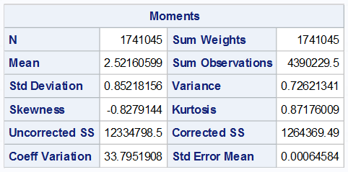
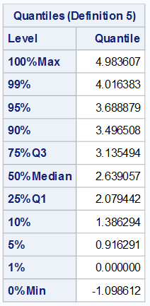
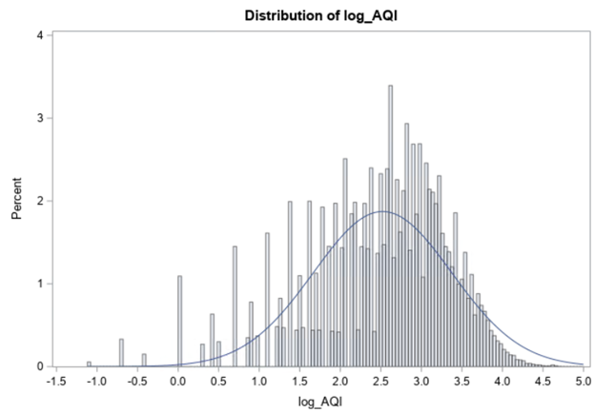
Transforming data via Log()
log_AQI =
log(overall_AQI)

Slide 9
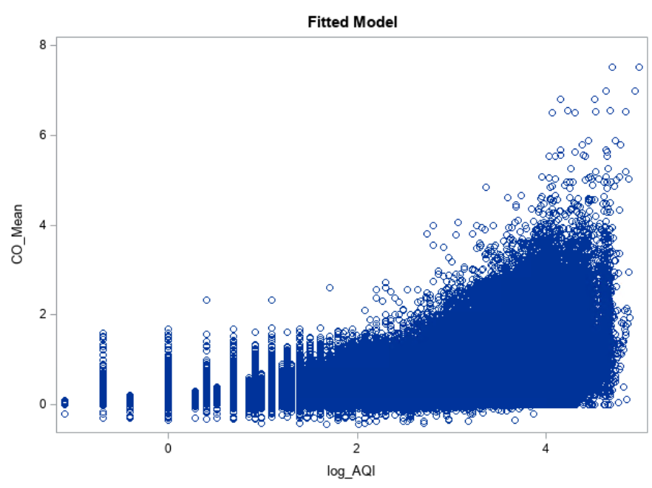
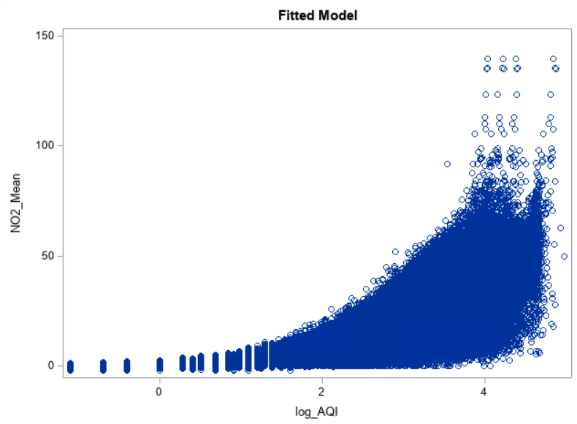
Discovery of Critical Relationships
NO2_Mean and CO_Mean showed the greatest correlation

Slide 10
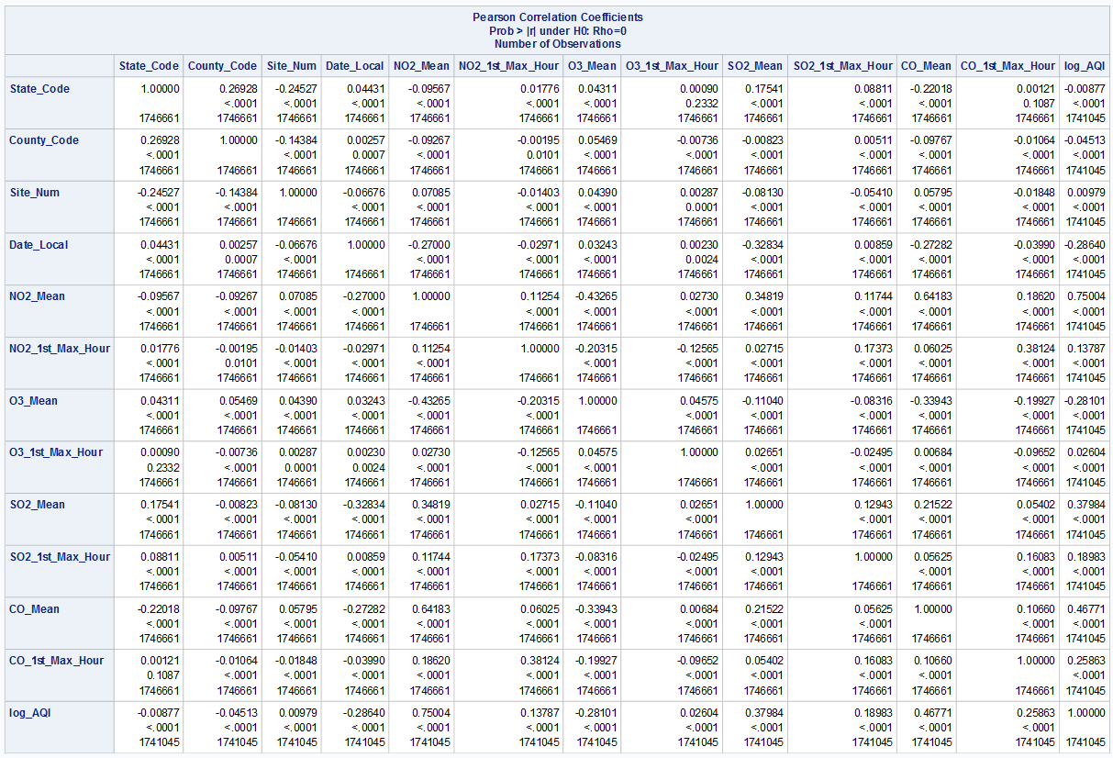

Slide 11
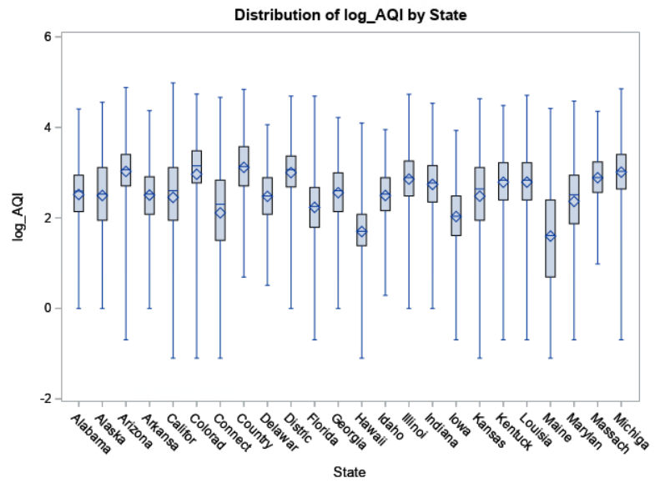
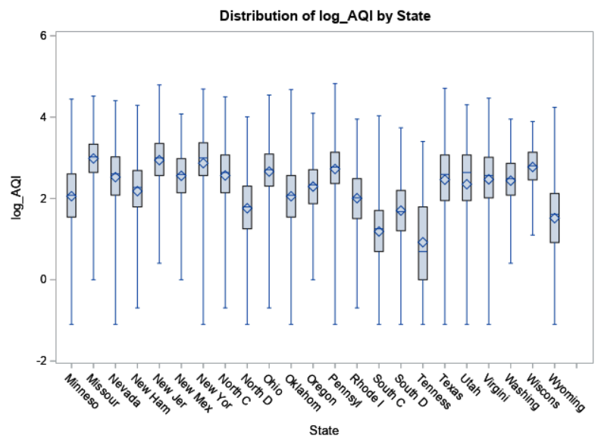
BoxPlot - Sasha Rukhina
Another graph we made was a boxplot of the log AQI in all 50 states. This shows that California has the worst air quality index in the country. Pennsylvania is the second worst state in the country, likely from it having a coal industry. The states with the best air quality index seem to be the northeastern states, like New Hampshire.

Slide 12
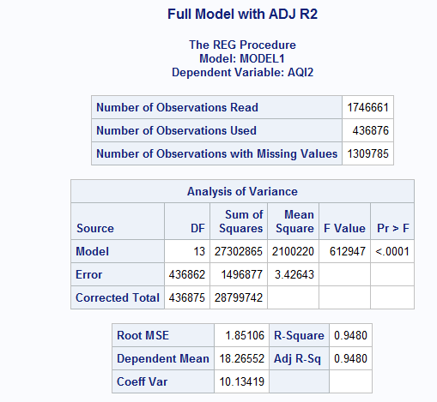
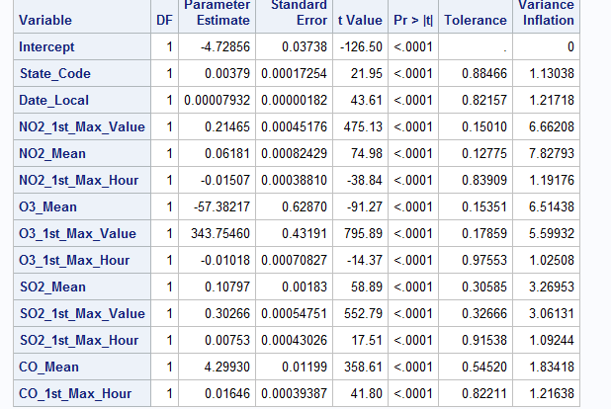
Full Model 1 - Selection = Adj R2 (Areeb Abubaker)

Slide 13
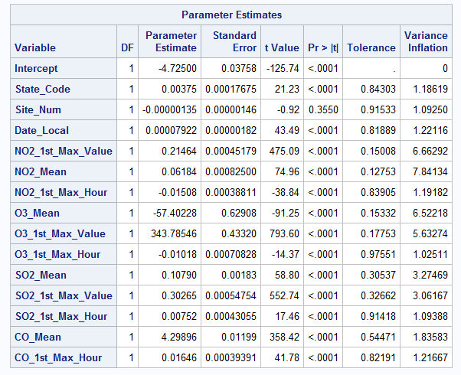
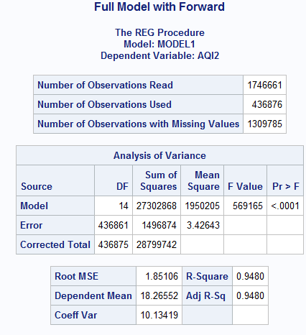
Full Model 2 - Using Forward Method (Areeb Abubaker)

Slide 14
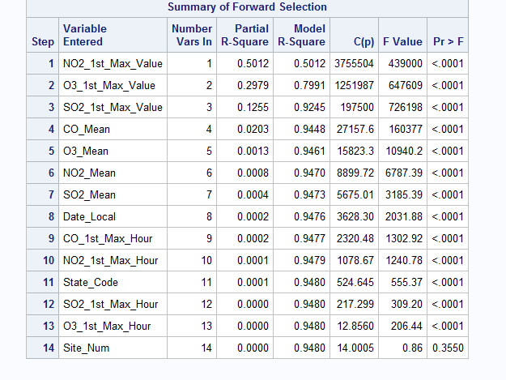

Slide 15
The Fitted Model - 3 (Areeb Abubaker)
The fitted model was made using the created variable of AQI2 as the dependant. It uses the mean and max values of other pollutants such as ozone, sulfur dioxide, and carbon monoxide. Overall the model has high correlation with an adjusted r squared value of about .95.

Slide 16
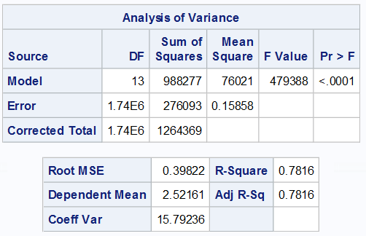
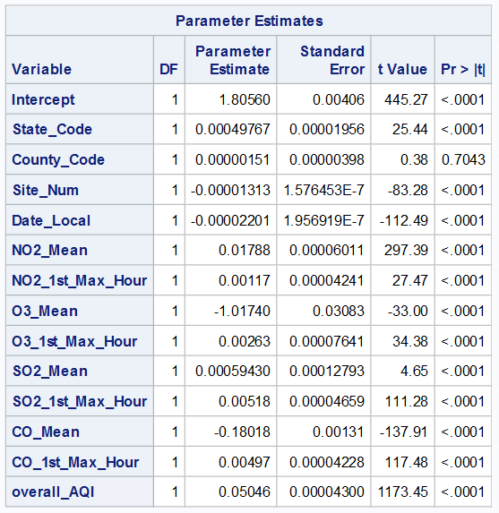
Areeb Abubaker

Slide 17
Graphs of the Fitted Model - 3 (AREEB ABUBAKER)
On to a better model statement with the variables removed

Slide 18
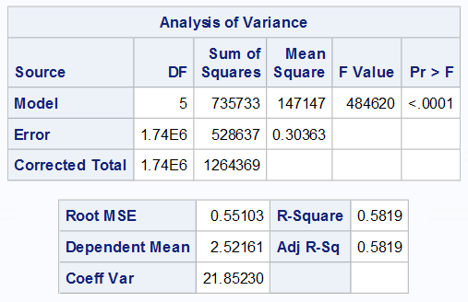
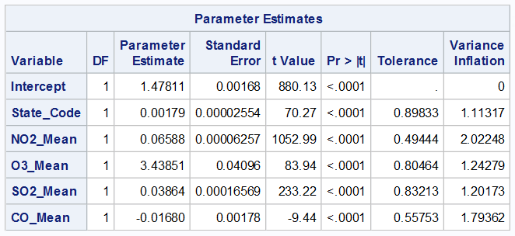

Slide 19
Cross Validation- Julio Delgado
We did a 5 fold cross validation test for two models to determine which model of the two models is better. We have found that the first model is better because it has the better test values and that is more important than the training values.The second model has a variable called Date_Local and it is insignificant because pollution does not change much day by day. Pollution changes over long periods of time so we cut that variable out of our final model.

Slide 20
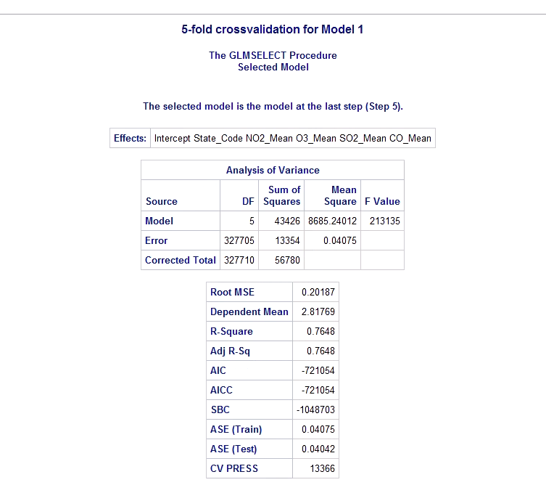

Slide 21
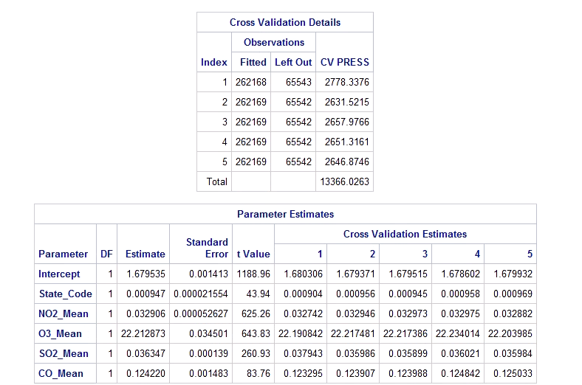

Slide 22
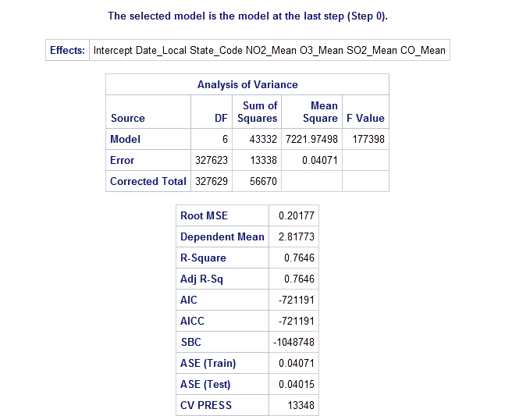

Slide 23
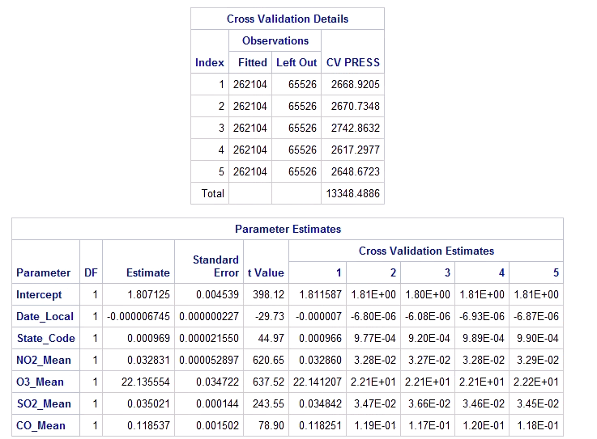

Slide 24
Conclusion- Jaime Moscoso
From our discovery of the 5 -fold cross validation ,we see that that the final model is better because we found out that this model has better test values and that would indicate that it is more important than the training values.. In addition, the fitted model that we made with the created variable of AQI 2 as the dependent We can see that the overall AQI has gone down since the 2000 and this would mean that the US has made efforts to bring down the AQI. This analysis can be beneficial in the future because it can be used in a precautious way to identify the AQI and if there is a need to decrease the levels of AQI.

